Slide 1
Fiscal Year 2026 Gunnery Sergeant Promotion Selection Board
Col John F. Campbell
Board President
Major William C. Griffin
Enlisted Promotion Head
MMPB, M&RA

Slide 2
Board Overview
Purpose: Consider the best and fully qualified Marines for promotion to meet the needs of the Marine Corps.
Board Membership (13)
(1) Colonel
(2) Lieutenant Colonels
(2) Majors
(1) Chief Warrant Officer 4
(1) Chief Warrant Officer 3
(7) Sergeants Major
(7) Master Gunnery Sergeants
Board Recorders: (3)
Total Above Zone (AZ) / In Zone (IZ) / Below Zone (BZ)
President screened the BZ for premier/non-premier
(80) BZ Premier Briefs
Average of approximately 265 total cases per member

Slide 3
Board Overview
Selection Board convened 4 February 2026
Monday – Saturday
0800 – 1730, with 10 minute breaks approx. every hour
Board Days Breakdown (34 days)
Admin Days: 2 / 8%
Days only preparing: 4 / 12%
Days only briefing: 5 / 14%
Days combined preparing/briefing: 25 / 74%
Prep time was approximately 30 minutes per case
Briefing time allocation: 3:00
Items that Increased Tempo
Further condensed brief for PME incomplete / request non-selection
Clear guidance from Board President throughout
Board Recorders development of a daily management / projection tool.
*Note: Board lost 2 days due to weather and 1 day due to network issues.

Slide 4
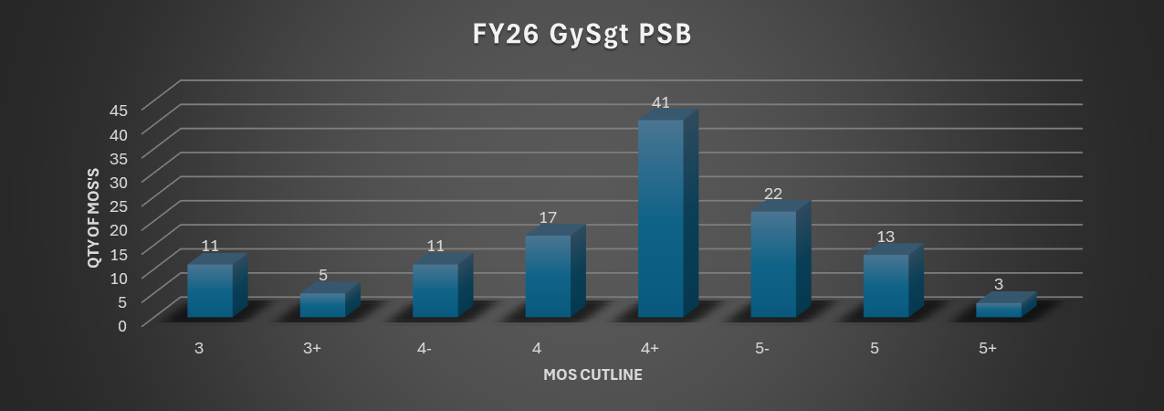
FY26 GySgt PSB Overview
Key Takeaways
2/3 of the MOS cutlines are above average (4+ and up)
16 MOS cutlines are below average (3+ or below)

Slide 5
FY26 GySgt PSB Overview
Statistics
Key Takeaways
Larger eligible population and allocations but lower selection rate.
PME incompletes were a major factor in shortfalls.
BZ Marines that were briefed had a 91% Selection Rate.
Note: PME requirement for GySgt is only the MCeLE Course EPME6000AA

Slide 6
Board Trends
PME Completion is the Primary "Gatekeeper": The most frequent discrepancy noted was the failure to complete required Enlisted Professional Military Education (EPME), specifically the Distance Education Program. Board members emphasized that even "outstanding" Marines were often briefed out simply because they were not PME complete.
The Value of Direct Promotion Recommendations: Board members look for explicit, enthusiastic language such as "Promote NOW" or "Promote ahead of peers". Conversely, "cookie-cutter" phrases like "Promote with peers" or "Promote at the needs of the Marine Corps" were not viewed as competitive.
Impactful Section I & K Narrative vs. "Fluff": High-value reports contain specific, quantifiable comments on technical expertise and leadership potential. Board members expressed frustration with "fluff"—comments that merely restate billet accomplishments or copy-paste previous reports rather than providing context for the Marine's performance.
Requirement for Record Accuracy and Ownership: A major concern is the prevalence of administrative errors, including missing FitReps, outdated PFT/CFT scores, and "invalid" degree entries. Board members urged Marines to "audit their record” and ensure its completeness.
Credibility Gaps in Evaluation Mismatches: A significant trend is the "disconnect" between numerical marks (Relative Value) and written comments. When an RS provides "glowing" comments but places a Marine in the lower third of their profile. Immense value was found in RS and RO comments that provided context behind why a Marine fell in a particular spot on a profile.

Slide 7

FY26 President Comments

Slide 8
Questions?

